Slide 1



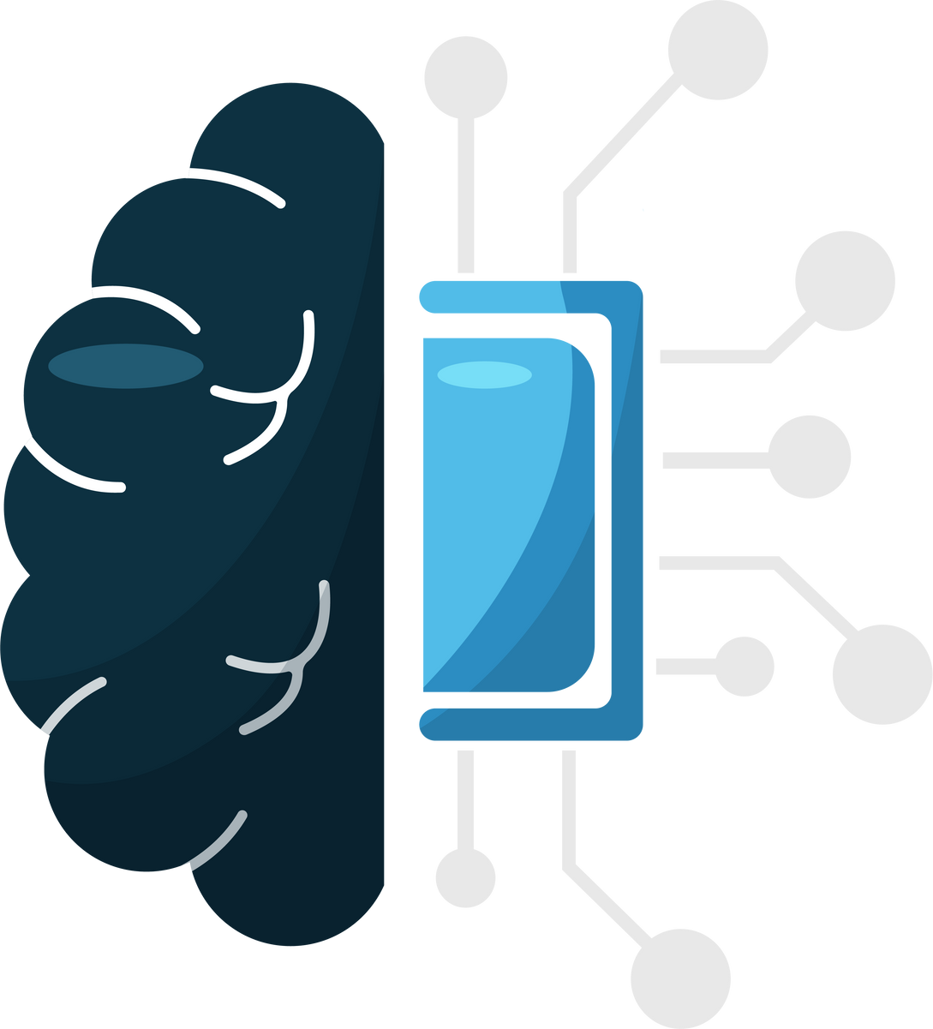

Understanding and Avoiding Phishing Attacks :
Protecting Yourself and Your Organization from Cyber Threats

Slide 2


PROJECT OVERVIEW
Definition of Phishing
Phishing is a cybercrime where attackers pose as legitimate entities to steal sensitive information like usernames, passwords, or financial details.
Key examples: Fake emails, malicious websites, fraudulent phone calls
Why It’s Dangerous
Financial theft.
Identity theft.
Compromise of sensitive personal or organizational data.

Slide 3


Common Phishing Techniques
Email Phishing:
Fake emails from seemingly trusted sources
Whaling:
Targeting executives or
high-profile individuals
Vishing:
Voice phishing through
phone calls.
Spear Phishing:
Personalized messages
targeting specific
individuals.
Smishing:
Phishing via SMS messages.

Slide 4



Recognizing Phishing Attempts
Red Flags in Emails
Urgent language (e.g., "Act now!").
Suspicious links or attachments.
Generic greetings (e.g., “Dear Customer”).
Fake Websites
Unsecured URLs (http vs. https).
Misspelled domain names (e.g., g00gle.com).
Poor design or functionality.
Social Engineering Tactics
Preying on emotions like fear, curiosity, or greed.
Impersonating authority figures (e.g., IT support or HR).

Slide 5




Avoiding Phishing Attacks
Best Practices for Individuals
Think before clicking links or downloading attachments.
Verify the sender’s identity independently.
Use strong, unique passwords.
Keep your software and antivirus updated.

Slide 6

What to Do if You Fall for Phishing ?
Immediate Actions:
• Disconnect from the internet.
Report the incident to your IT or security team.
Change affected passwords.
Monitor financial and personal accounts for unusual activity.
What to Do if You Fall for Phishing
Immediate Actions:
Disconnect from the internet.
Report the incident to your IT or security team.
Change affected passwords.
Monitor financial and personal accounts for unusual activity.

Slide 7



CONCLUSION
Stay Vigilant:
Phishing is a dynamic and evolving threat.
Awareness and proactive measures can mitigate risks.
Key Takeaway:
"Think before you click!"

Slide 8





THANK YOU

